Slide 1
Diamond Price Prediction
WISDOM IZUCHUKWU ADIKE

Slide 2
Content
Dataset Description
Main objectives of the analysis.
Applying various regression models.
Machine learning analysis and findings.
Models flaws and advanced steps.

Slide 3
Dataset Description

Slide 4
Introduction
This project involves predicting the price of approximately 54,000 diamonds based on various attributes. These attributes include the weight (carat), dimensions (length, width, and depth), depth percentage (%Depth), table width, and quality, color, and clarity ratings. The goal is to build a predictive model that can accurately estimate the price of diamonds based on these features, which are crucial determinants in the diamond pricing market. This prediction task holds significant value for both buyers and sellers in the diamond industry, aiding in informed decision-making and price assessment.

Slide 5
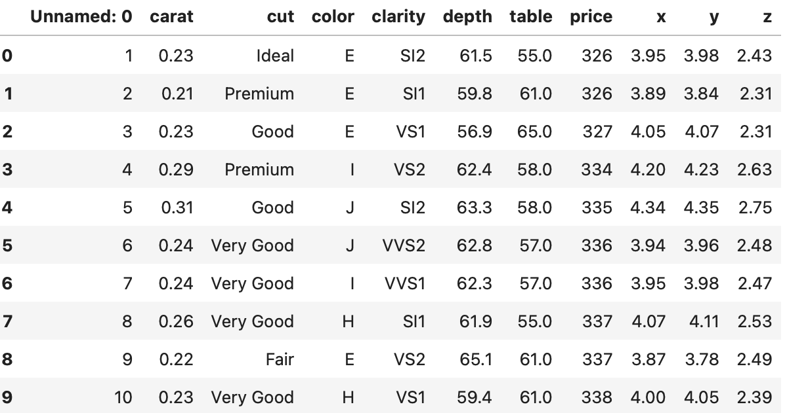
Dataset Description 01
You'd notice 'Unnamed: 0' column similar to the indexing. We will drop the column.

Slide 6
Dataset Description 02
carat: weight of the diamond.
x: Length of the diamond.
y: Width of the diamond.
z: Depth of the diamond.
depth: Depth percentage. Formula: z / mean(x, y) = 2 * z / (x + y)
table: Width of top of the diamond relative to the widest point.
cut: Quality of the diamond. Possible values (from best to worst)
color: Color of the diamond. Possible values: from D (best) to J (worst).
clarity: Measurement of how clear the diamond is. Possible values (from best to worst): IF, VVS1, VVS2, VS1, VS2, SI1, SI2, I1.
price: price of the diamond in US dollars.

Slide 7
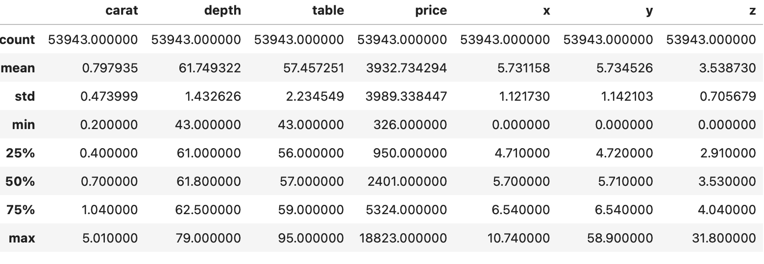
Dataset Description 03
Mean:
Carat: 0.8
Depth: 62
Price: 3932
Min:
Carat: 0.2
Depth: 43
Price: 326
Max:
Carat: 5.0
Depth: 79
Price: 18823

Slide 8
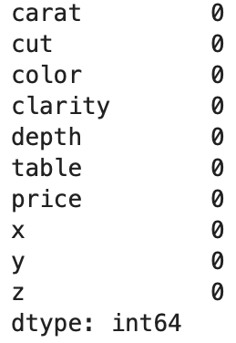
Dataset Description 04
You can see we have no missing values in our dataset. Hence, no need for handling missing values.

Slide 9
Data Analysis

Slide 10
Main Objective of the Analysis
In this section, I'm visualizing feature correlations through pairplots to identify relevant features. Following that, I'll construct various regression models using advanced techniques, including GridSearch, ML pipelines, and hyperparameter tuning. The objective is to obtain the most accurate predictive model while highlighting the shortcomings of each model.

Slide 11
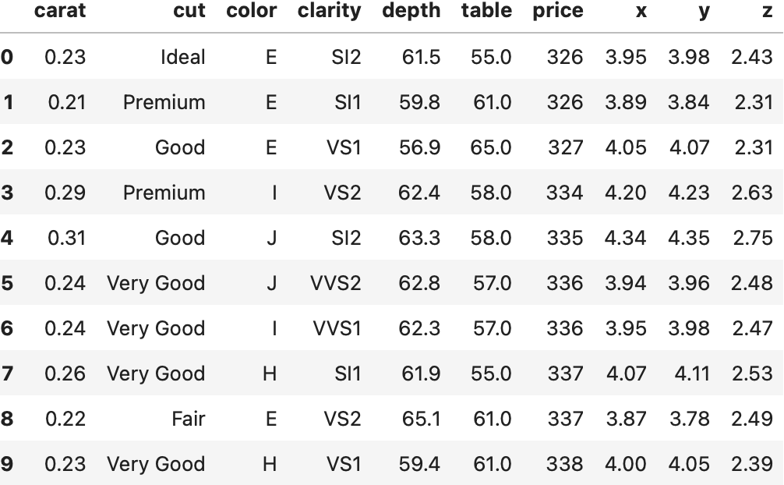
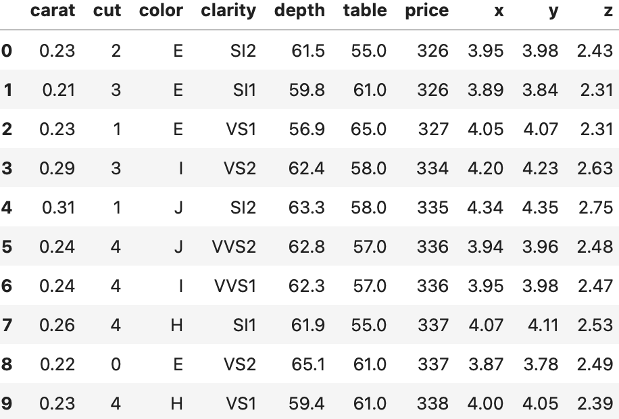
Data Analysis 01
From the both tables, you will notice we converted the ordinal categorical variable 'cut' to a numerical variable.

Slide 12
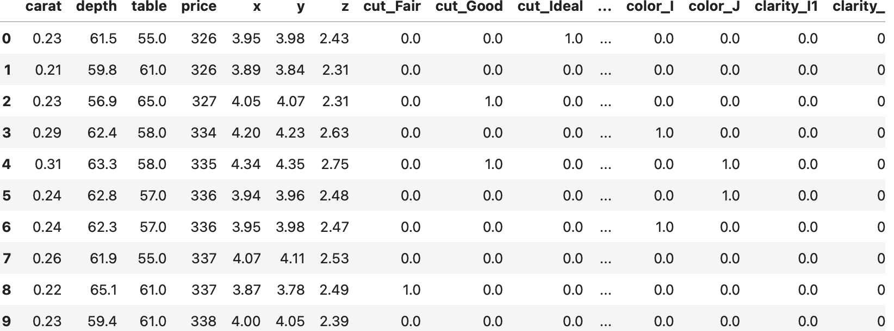
Data Analysis 02
Performed One-Hot encoding on the continuous categorical variables.

Slide 13
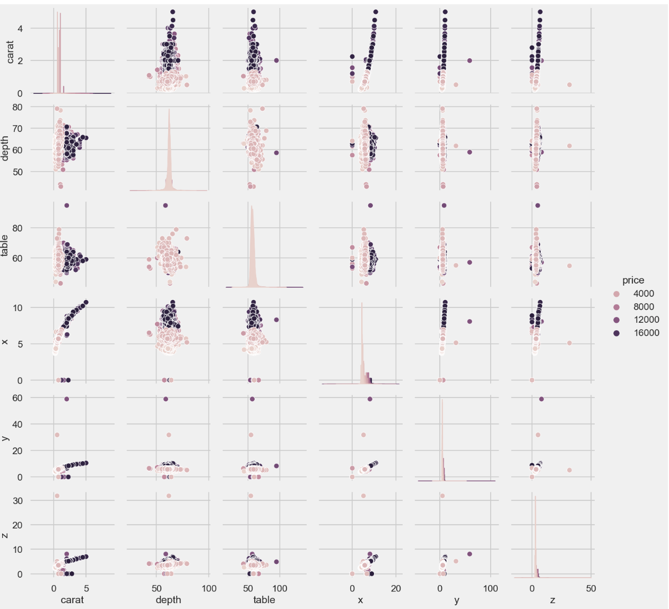
Data Analysis 03
A pairplot showcasing the relationship and the trend between the diamond features.

Slide 14
Machine Learning Analysis and Findings

Slide 15
Machine Learning Analysis and Findings.
In the upcoming analysis, I will conduct a comparison among four distinct regression models: Vanilla, Lasso, Ridge, and ElasticNet. The primary focus will be on assessing their accuracy in predicting Diamond prices. To achieve robust modeling, I'll employ various techniques including standard scaling, polynomial effects, regularization regression, cross-validation, and grid search. I'll also evaluate model performance using metrics such as RMS and R2 Score.

Slide 16
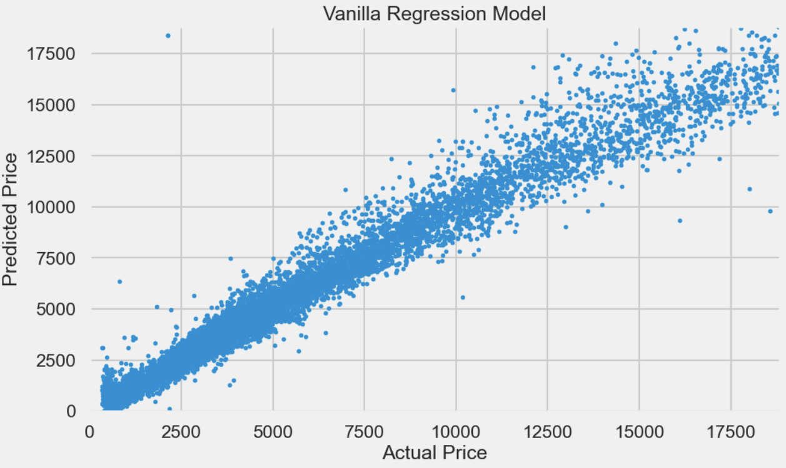
Machine Learning Analysis 01
Vanilla Regression Model:
Model features and parameter:
Model: LinearRegression()
Polynomial features: Degree = 2
StandardScaler
RMSE Score | R2 Score
1588.8188353340868 | 0.8369282829489186

Slide 17
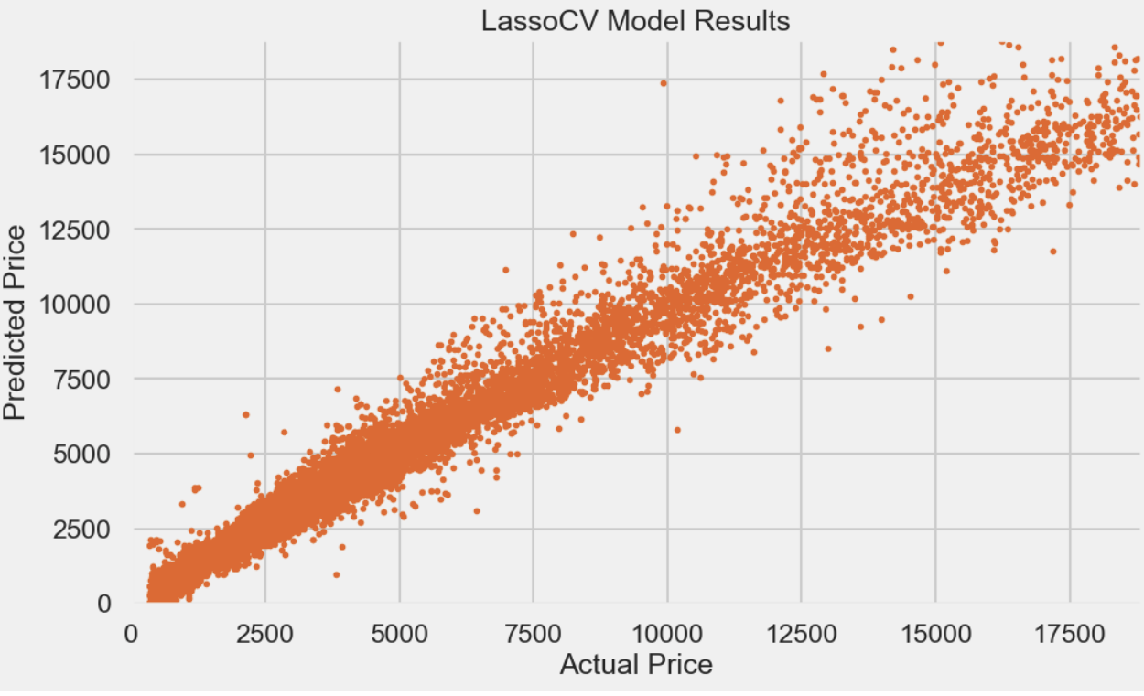
Machine Learning Analysis 02
Lasso Regression Model:
Model features and parameter:
Model: LassoCV()
Polynomial features: Degree = 2
StandardScaler
Alpha = 5.3792
max_iter = 10,000
RMSE Score | R2 Score
702.6860954874735 | 0.968102796835838

Slide 18
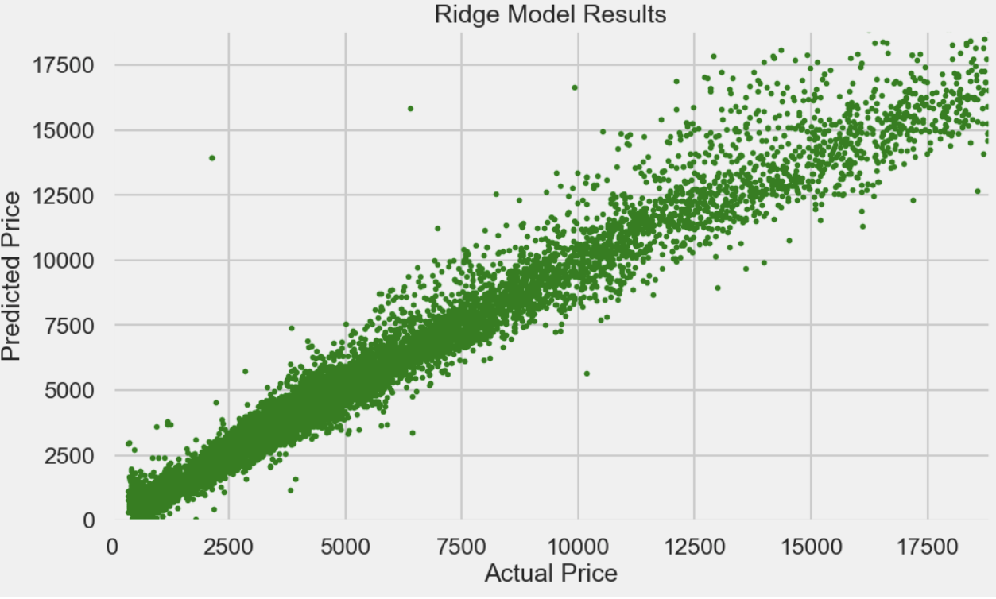
Machine Learning Analysis 03
Ridge Regression Model:
Model features and parameter:
Model: RidgeCV()
Polynomial features: Degree = 2
StandardScaler
Alpha = 20.0
max_iter = 10,000
RMSE Score | R2 Score
791.7394738480549 | 0.959505645454924

Slide 19
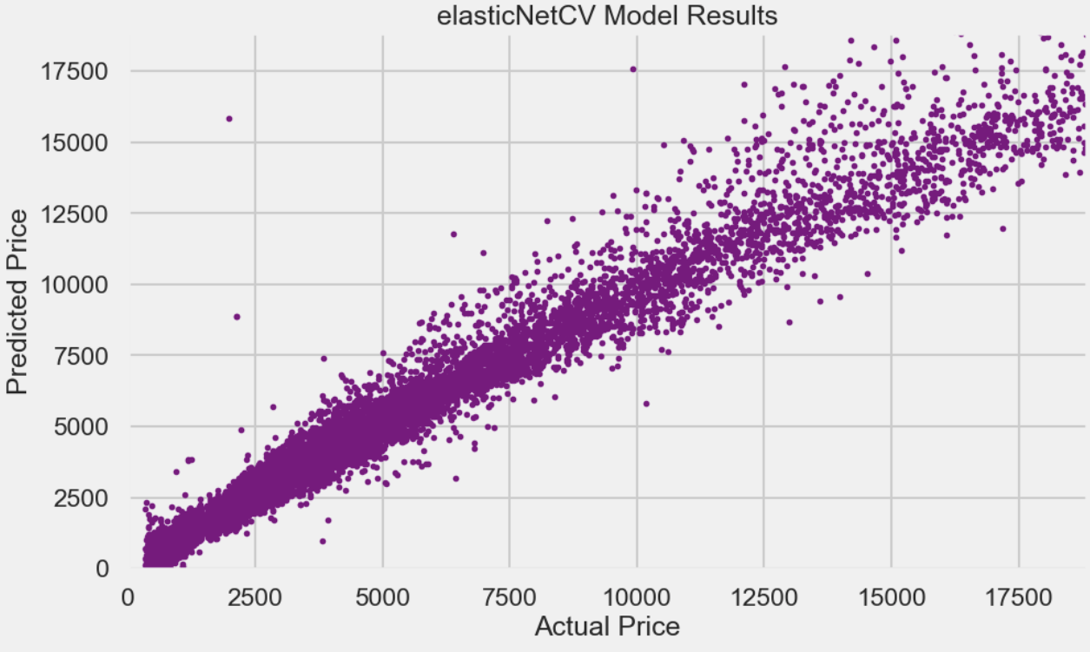
Machine Learning Analysis 04
ElasticNet Regression Model:
Model features and parameter:
Model: ElasticNetCV()
Polynomial features: Degree = 2
StandardScaler
Alpha = 0.12328
L1 Ratio = 0.9
max_iter = 10,000
RMSE Score | R2 Score
717.0028927778961 | 0.959505645454924

Slide 20
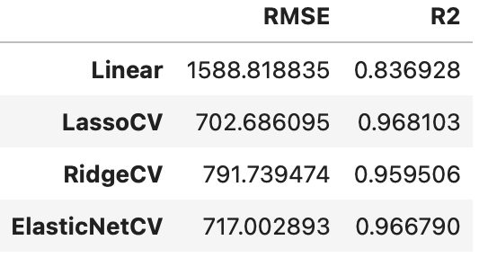
Machine Learning Analysis 05
As depicted in the data frame, all models yield excellent prediction results, with very minimal differences between them aside Linear which is a bit lower but with a high RMSE. However, the final model selection hinges on identifying the one with the highest R2 score outcome.
I have arranged the models in ascending order as follows:
Linear
RidgeCV
ElasticNetCV
LassoCV

Slide 21
Model Flaws and Strength and advanced steps

Slide 22
Model Flaws and Strength and Advanced steps:
In terms of simplicity, it's worth noting that vanilla linear regression delivered respectable predictive results, although not the absolute best. It stands out as the simplest and fastest model in terms of parameters. On the other hand, models like Lasso, Ridge, and ElasticNet yielded higher results in accuracy, but they introduced complexity and slowed down the training process, particularly when employing grid search to fine-tune parameters. This presents a tradeoff scenario: for larger datasets, these more complex models may offer superior performance, albeit with longer training times, whereas opting for the vanilla model might involve a slight accuracy sacrifice but significantly faster training.
In terms of the best model, LassoCV comes with the highest R2 score and we can't ignore that despite its training process is slow.

Slide 23
Advanced Steps:
To boost the model's effectiveness, we utilize regularization techniques such as L1 (Lasso) and L2 (Ridge) to manage overfitting and stabilize coefficients. Furthermore, the inclusion of k-fold cross-validation assists in evaluating the model's resilience and fine-tuning hyperparameters, ensuring its ability to generalize effectively across various data subsets. These methods together result in heightened model accuracy and dependability in regression applications.

Slide 24
Thank you
WISDOM IZUCHUKWU ADIKE

